Slide 1

SWARNANDHRA COLLEGE OF
ENGINEERING AND TECHNOLOGY
STEGANOGRAPHY WITH AUDIO,VIDEO,IMAGES USING SWINGS
COMPUTER SCIENCE AND ENGINEERING
PROJECT MEMBERS
K Ajay Vamsee (16A21B0534) P Pratap (16A21B0548)
N Dinesh (16A21B0542) V C B S Swamy (17A25B0501)
PROJECT GUIDE : Dr. Veeramani Thangavel

Slide 2
CONTENTS
Introduction
Abstract
Literature Survey
System Analysis
Hardware and Software Requirements
Architecture Diagram
Uml Diagrams
Modules
Spiral Model And Methods
Steganography Techniques
Audio Image Video
Advantages & Disadvantages
Screenshots
Conclusion
Future Enhancement
Reference

Slide 3
INTRODUCTION
Steganography is a method of hiding secret data, by embedding it into an audio, video, image or text file. It was invented by a German named Trithemius. It is one of the methods employed to protect secret or sensitive data from malicious attacks.
It is a platform independent application so that it can be used on any operating system.
Provides security for the information which is passed over the net.
Information is embedded into the Audio, Video & Image file.

Slide 4
Abstract
Steganography with Image ,Audio and Video is swings based application.
It happens with Audio, Video &Image File for transferring more secure sensitive data.
The Sensitive Data is Encoded with an Audio, Video & Image File and Passed over Insecure Channels to other end Systems.
Here we can use any file Format for Encryption and Decryption of Message.
Steganography techniques are needed to ensure the integrity of data stored on a machine that may be infected or under attack.

Slide 5
SYSTEM ANALYSIS
EXISTING SYSTEM | PROPOSED SYSETM
The application is platform dependent. | The application is platform independent.
Supports any one either command mode or graphical mode. | Supports both command mode and graphical mode.
Advantages: Should be applicable for any kind of image size for Steganography. | Advantages: Provide interactive interface through which with different types images, Images Sizes and text Messages.
Disadvantages: Message length is restricted to 500 characters Lack in good user interface Consume much time to encode and decode | Disadvantages: File may not be sent through any secure channel.

Slide 6
Hardware and Software Requirements
Tools & Development Environment:
Operating System : Microsoft Windows XP/2000 or Higher
Clients: CONSOLE
Development Tools: Net beans 6.x ,Myecllipse 6.x,NotePad.
Documentation Tools: MS Office 2007/2010
Drawing Tools: IBM Rational Rose Enterprise, MS Office Visio 2007
User Interface: AWT & SWINGS
Code Behind: AWT AND SWINGS
Client Side
 | Processor | RAM | Disk Space
Console | Computer with a 2.6GHz processor or higher (Pentium processor recommended) | 512MB Minimum | Minimum 20 GB
Net Beans 6.8 | Intel Pentium Processor at 2.6GHz or faster | Minimum 512 MB Physical Memory; (1 GB Recommended) | Minimum 20 GB

Slide 7
SWINGS
Java Swing is a part of Java Foundation Classes (JFC) that is used to create window-based applications. It is built on the top of AWT (Abstract Windowing Toolkit) API and entirely written in java.
Unlike AWT, Java Swing provides platform-independent and lightweight components.
import javax.swing.*;
The javax.swing package provides classes for java swing API such as JButton, JTextField, JTextArea, JRadioButton, JCheckbox, JMenu, JColorChooser etc.

Slide 8
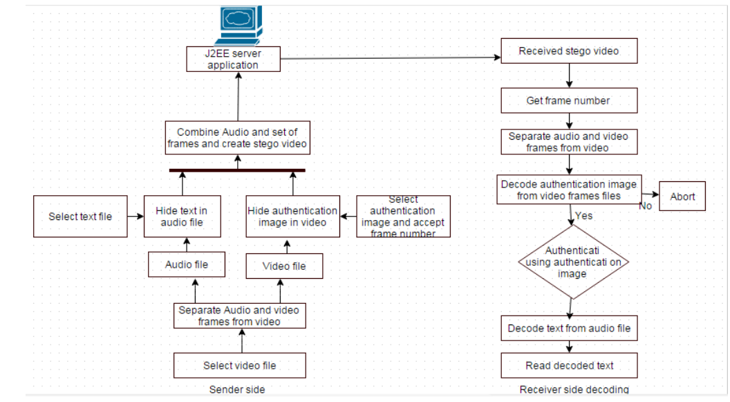
Architecture
Image

Slide 9
UML Diagrams
Class Diagram

Slide 10
SEQUENCE DIAGRAM

Slide 11
COLLABORATION DIAGRAM

Slide 12
ACTIVITY DIAGRAM
Plaintext
encryption
Decryption
Retrieve the message

Slide 13
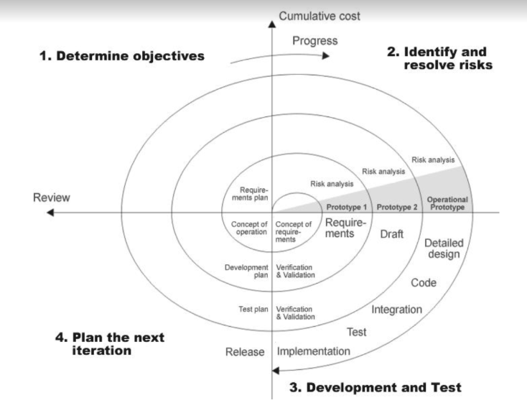
Spiral Model And Methods

Slide 14
Steganography Techniques
Depending on the nature of the cover object(actual object in which secret data is embedded), steganography can be classified into three types:
Image Steganography
Video Steganography
Audio Steganography

Slide 15
Hiding a Message inside Images
The most popular medium!
Least-significant bit (LSB) modifications
24-bit vs. 8-bit images
Tools to implement LSB: EzStego and S-Tools
Masking and Filtering
Logic’s and Transformation

Slide 16
Hiding a Message inside Audio
Data is hidden by modifying sample data.
Uncompressed audio formats-WAV,BWF,MBWF.
Compressed audio formats
Lossy-MP3,AAC(Advanced audio coding)
Lossless audio formats
-FLAC(Free Lossless Audio Codec),DST(Direct Stream Transfer)

Slide 17
Hiding a Message inside Videos Files
In Video Steganography you can hide kind of data into digital video format. The advantage of this type is a large amount of data can be hidden inside and the fact that it is a moving stream of images and sounds. You can think of this as the combination of Image Steganography and Audio Steganography. Two main classes of Video Steganography include:
Embedding data in uncompressed raw video and compressing it later
Embedding data directly into the compressed data stream

Slide 18
ADVANTAGES AND DISADVANTAGES
ADVANTAGES:
Difficult to detect and only receiver can detect.
It can be done faster with large no.of software.
Provides better security for sharing data in LAN,MAN,WAN.
DISADVANTAGES:
It can’t be transfer through secure channels.
Password leakage may occur and it leads to the unauthorized access of data.
If this technique(tool) is gone in the wrong hands like hackers can be very much dangerous for all.

Slide 19
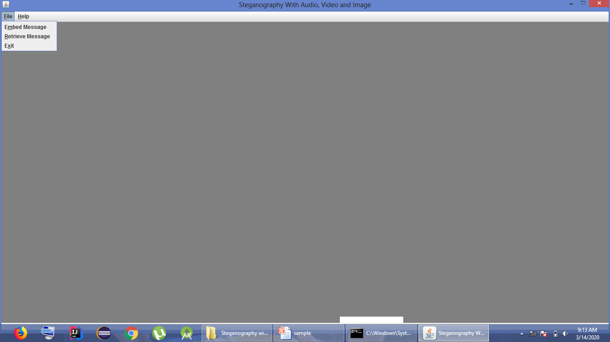
Screenshots

Slide 20
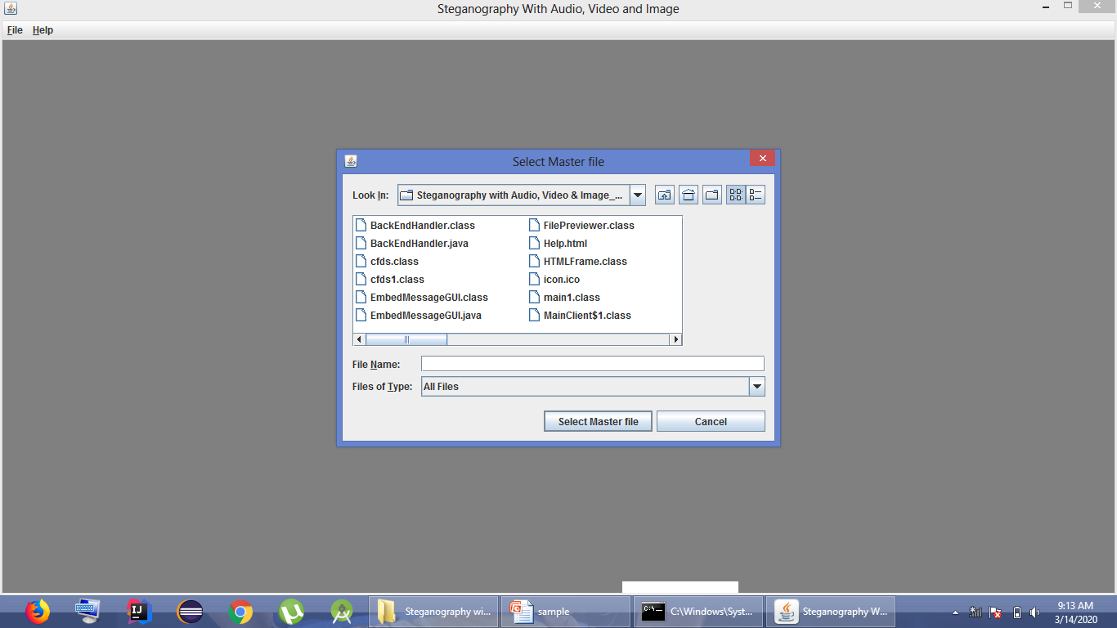
SELECTING FILE

Slide 21
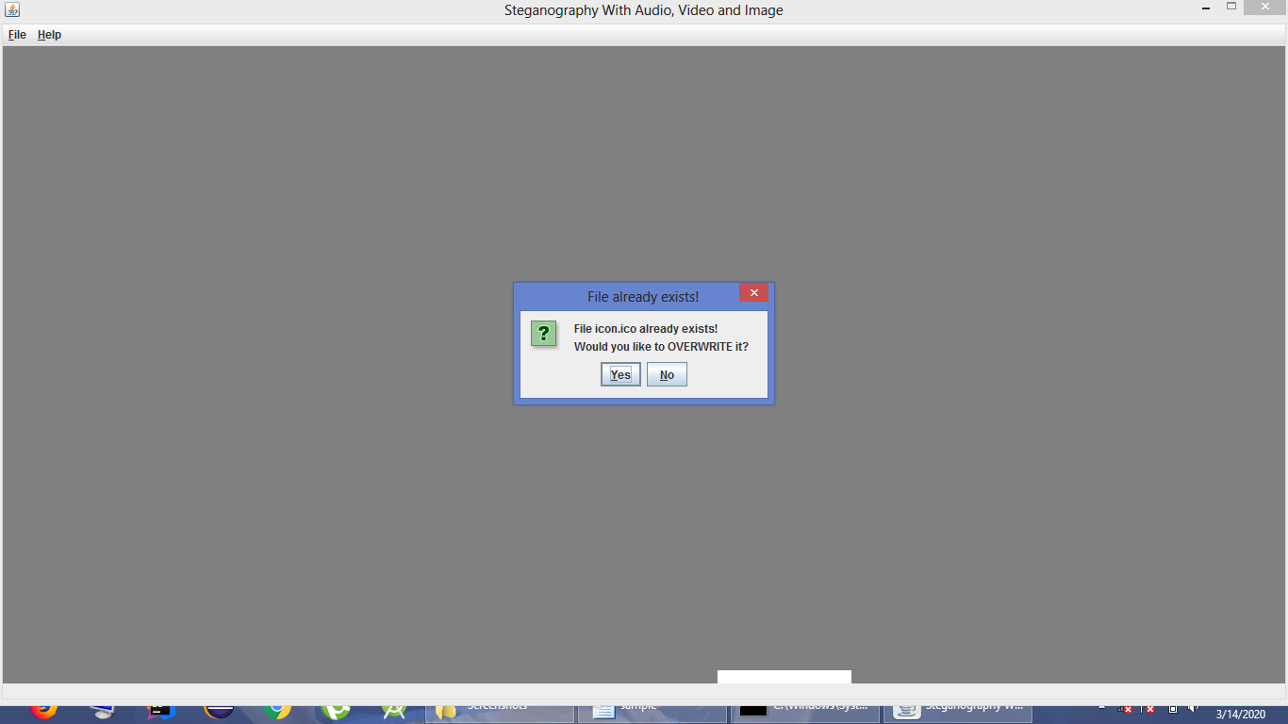
OVERWRITING FILE

Slide 22
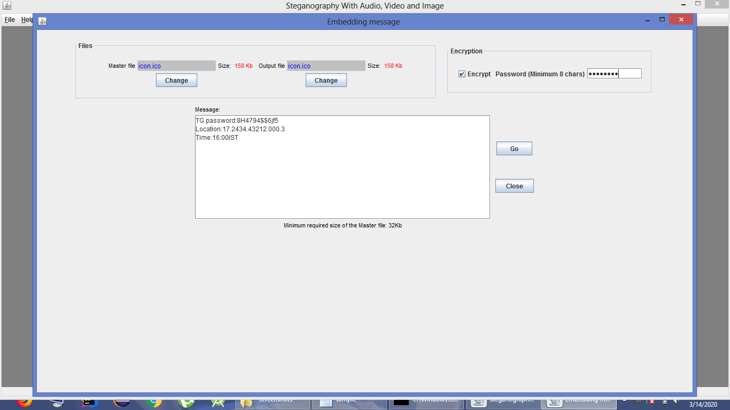
EMBEDDING MESSAGE

Slide 23
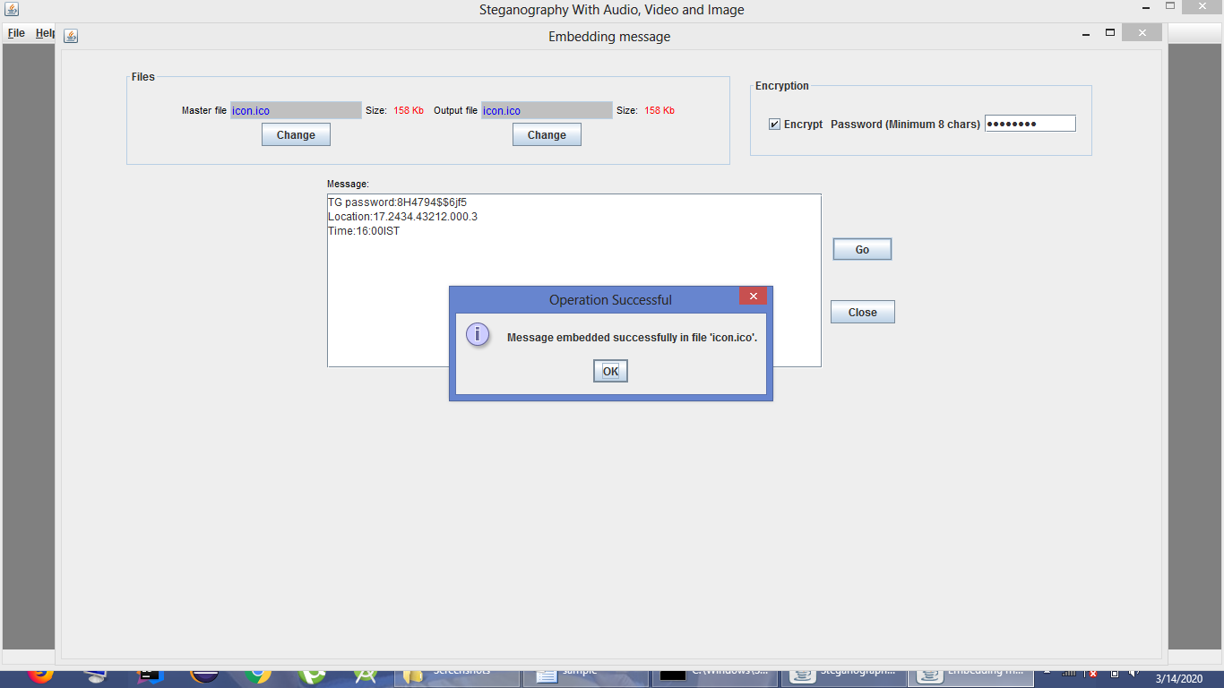
Success Note

Slide 24
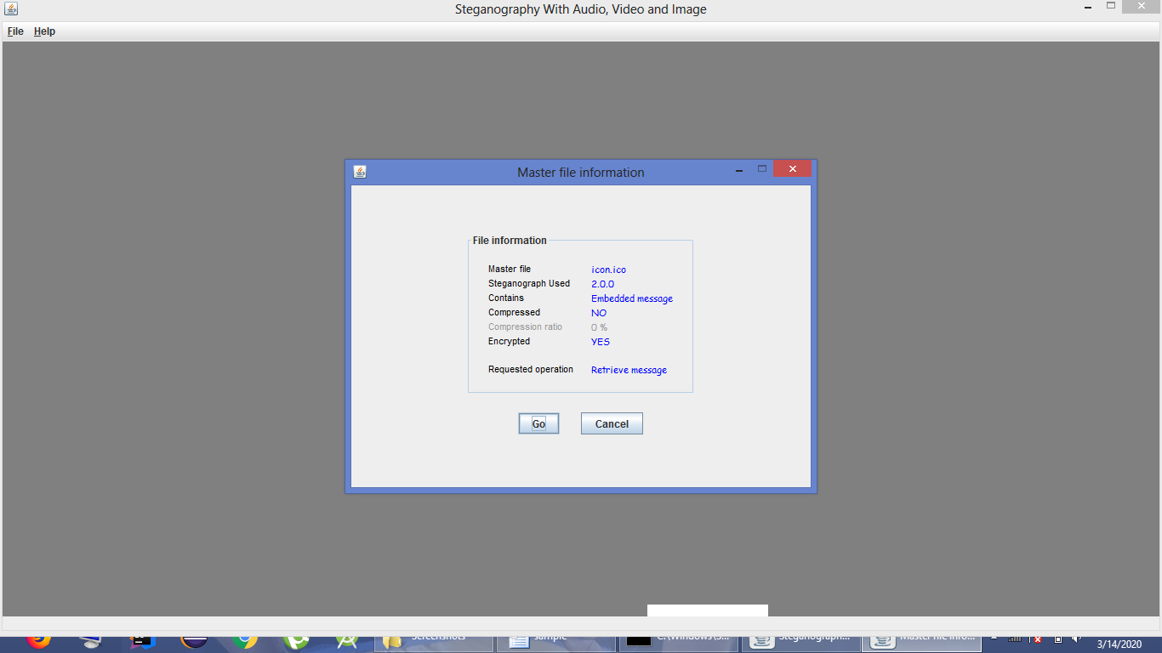
Master File Info

Slide 25
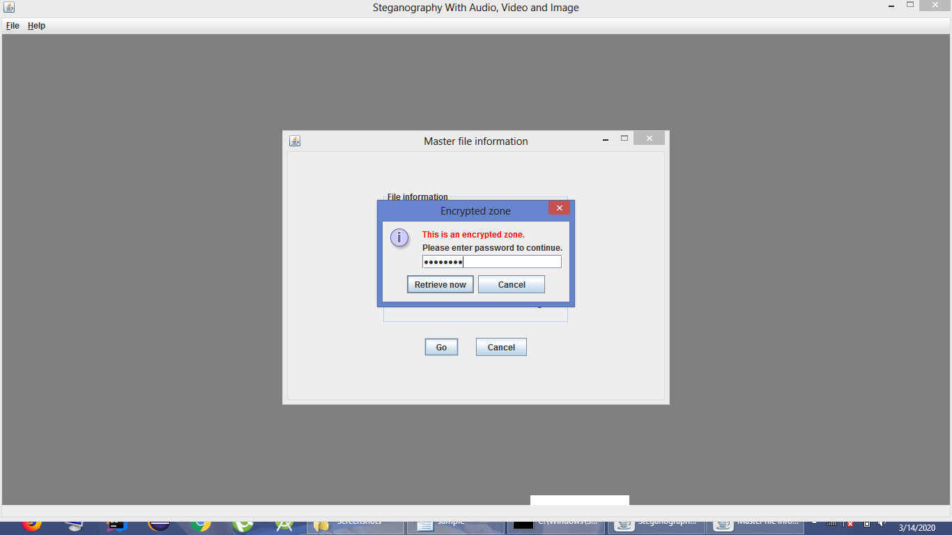

Slide 26
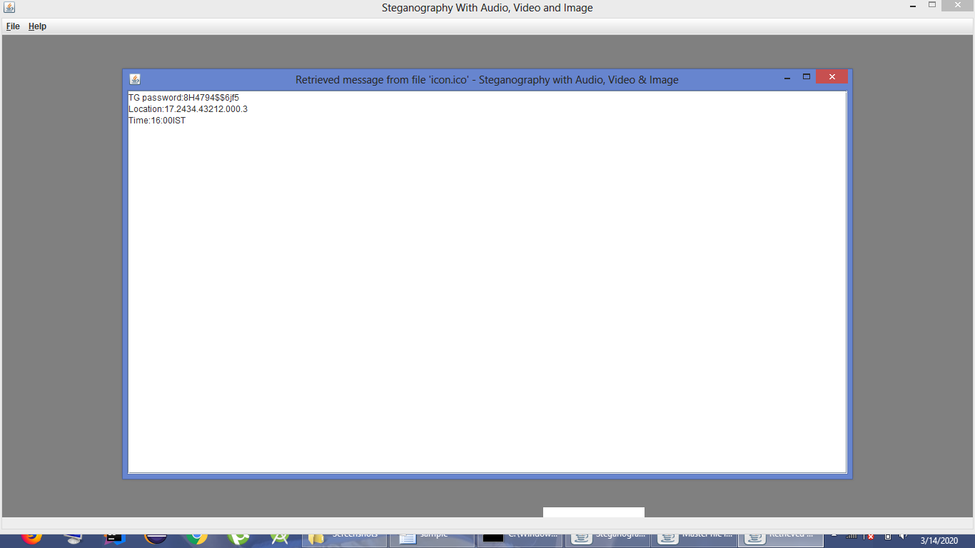

Slide 27
Conclusion
The growth of modern communication needs a special means of security especially on computer network. As there appears a risk that the sensitive information transmitted might be intercepted or distorted by unintended observers for the openness of the internet. So it has resulted in an explosive growth in secure communication and information hiding. Moreover, the information hiding technique can be used extensively in applications like business, military, commercials, anti-criminal, digital forensic and so on.
Steganography is the technique of secret communication which has received much attention. In this thesis image based steganography methods have been proposed to increase the performance of the data hiding techniques. This these is focuses on the analysis and development of image steganography techniques that can hide data with a low detection rate and high payload.

Slide 28
Future Enhancement
The future work on this project is to improve the compression ratio of theimage to the text. This project can be extended to a level such that it can beused for the different types of image formats like . bmp.
Improve security and application performance.
It may be possible to detect a simple Steganographic technique by simple analyzing the low order bits of the image bytes.

Slide 29
Reference
[1] G. Prashanti, K. Sandhyarani, “A New Approach for Data Hiding with LSB Steganography”, Emerging ICT for Bridging the Future - Proceedings of the 49th Annual Convention of the Computer Society of India CSI, Springer 2015, pp. 423-430.
[2] S. Goel, S. Gupta, N. Kaushik, “Image Steganography – Least Significant Bit with Multiple Progressions”, Proceedings of the 3rd International Conference on Frontiers of Intelligent Computing: Theory and Applications (FICTA), Springer 2014-2015, pp. 105-112.
[3] D. Baby, J. Thomas, G. Augustine, E. George, N.R. Michael, “ A Novel DWT based Image Securing method using Steganography”, International Conference on Information and Communication Technologies (ICICT), Procedia Computer Science, April 2015, pp. 612-618.
[4] B. Feng, W. Lu, and W. Sun, “Secure Binary Image Steganography Based on Minimizing the Distortion on the Texture”, IEEE transactions on Information Forensics and Security, Feb. 2015.
[5] M. Nusrati, A. Hanani and R. Karimi, “Steganography in Image Segments Using Genetic Algorithm”, 5th IEEE International Conference on Advanced Computing & Communication Technologies (ACCT), Feb 2015, pp. 102-107.

Slide 30

Thank you…

